Slide 1
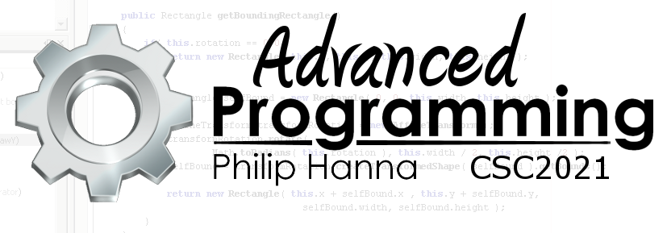
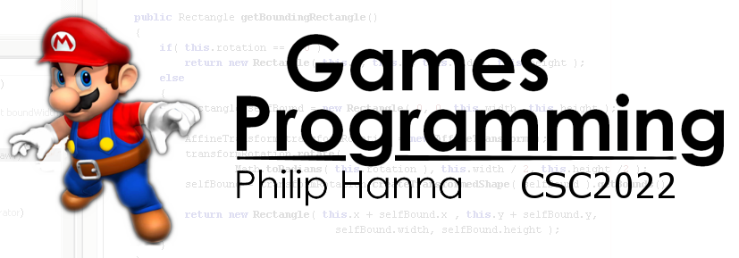
Graphics
Images within 2D games
Part 4 – Transforms

Slide 2
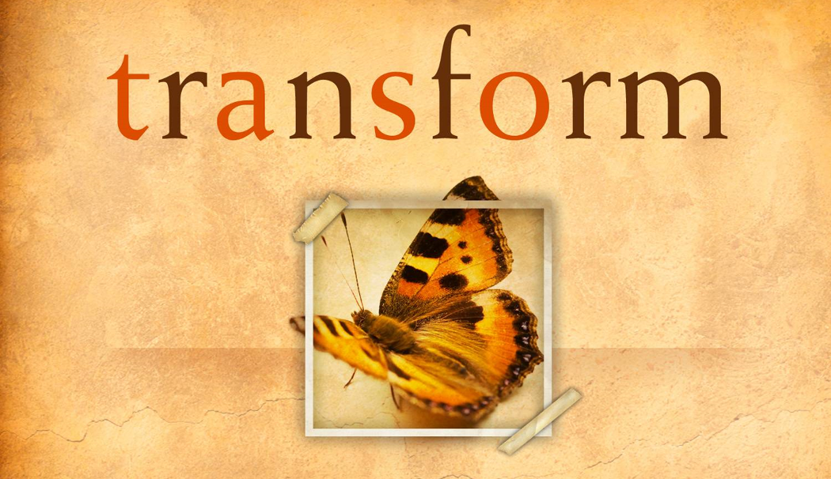
Image Transformations

Slide 3
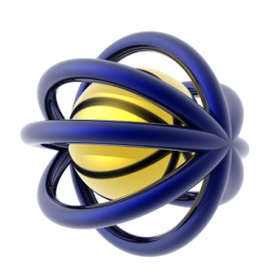
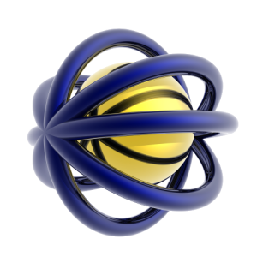
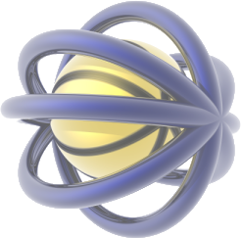
Basic forms of image transform
A number of affine image transforms can be usefully employed within games, including:
Resizing
Rotating
Fadding
Flipping

Slide 4
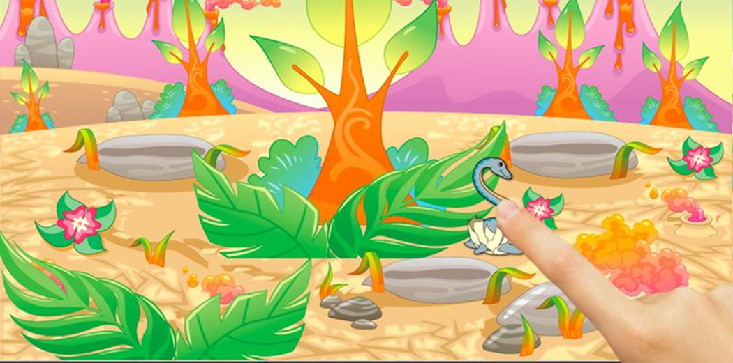
Image Transforms: Resizing

Slide 5
1 | Bitmap image; // Loaded bitmap (assume 100x100)
2 | Rect source = new Rect();
3 | Rect destination = new Rect();
4 | Paint paint = new Paint();
5 | Matrix matrix = new Matrix();
The source will be scaled to fit the destination.
sourceX,sourceY
destX, destY
sourceWidth
destinationWidth
1 | protected void onDraw(Canvas canvas) {
2 | // Copy a 50x50 region from the centre and
3 | // enlarge to 100x100 drawn at pos [25,25]
4 | source.set(25, 25, 75, 75);
5 | destination.set(25, 25, 125, 125);
6 | canvas.drawBitmap(
7 | image, source, destination, paint);
8
9 | // Scale the whole image using a matrix
10 | matrix.setScale(2.0f, 2.0f);
11 | matrix.postTranslate(25, 25);
12 | canvas.drawBitmap(image, matrix, paint);
sourecHeight
destination Height
Ideal for:
Depth of view effects
Object reuse
Zoom in and out

Slide 6
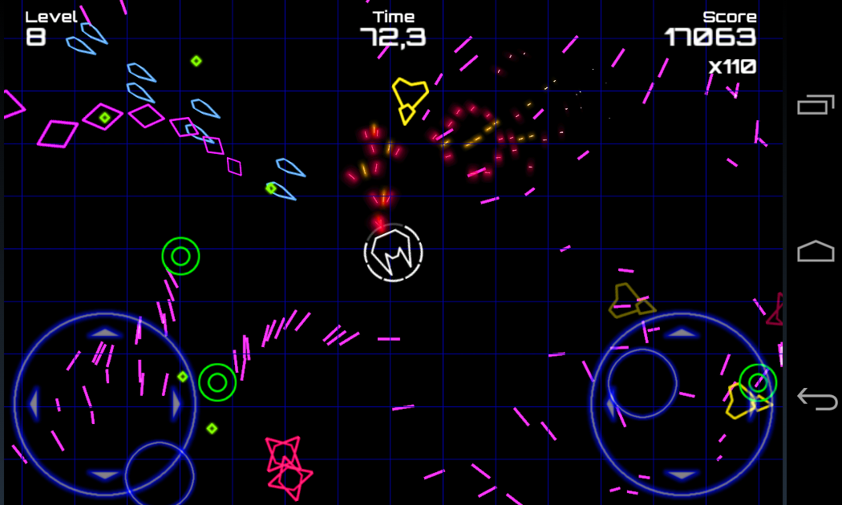
Image Transforms: Rotation

Slide 7
The source will be rotated around the specified origin
1 | Bitmap image; // Loaded bitmap (assume 100x100)
2 | Paint paint = new Paint();
3 | Matrix matrix = new Matrix();
1 | protected void onDraw(Canvas canvas) {
2 | // Clockwise rotations of 15 degrees around
3 | // [0,0] – before translation, top-left corner
4 | matrix.reset();
5 | matrix.setRotate(15.0f);
6 | matrix.postTranslate(50.0f, 50.0f); // Draw pos
7 | canvas.drawBitmap(image, matrix, paint);
8
9 | // Do the same thing about the bitmap’s centre
10 | matrix.reset();
11 | matrix.setRotate(15.0f, 50.0f, 50.0f);
12 | matrix.postTranslate(50.0f, 50.0f); // Draw pos
13 | canvas.drawBitmap(image, matrix, paint);
Point of rotation
Ideal for:
Top down games
Spinning gfx

Slide 8
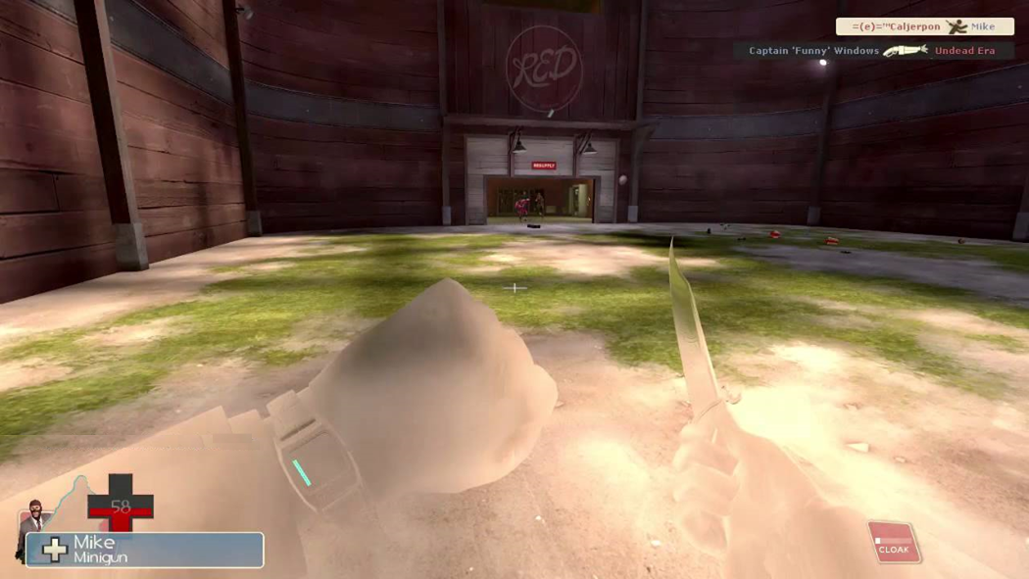
Image Transforms: Fading

Slide 9
1 | Bitmap image; // Loaded bitmap (assume 100x100)
2 | Paint paint = new Paint();
The source alpha will be multiplied with the specified alpha value.
1 | protected void onDraw(Canvas canvas) {
2 | // Draw the bitmap at location [100,100]
3 | // with 50% fade (alpha value of 128/255)
4 | paint.setAlpha(128);
5 | canvas.drawBitmap(image, 100.0f, 100.f, paint);
6 | paint.setAlpha(255); // Reset the alpha value
7
50% alpha
100% alpha
Ideal for:
Appear and disappear effects

Slide 10

Image Transforms: Flipping

Slide 11
The source rectangle will be flipped relative to the destination
1 | Bitmap image; // Loaded bitmap (assume 100x100)
2 | Rect source = new Rect();
3 | Rect destination = new Rect();
4 | Paint paint = new Paint();
1 | protected void onDraw(Canvas canvas) {
2 | // Copy a 50x50 region from the centre and
3 | // draw to a 50x50 region at pos [400,50]
4 | source.set(25, 25, 75, 75);
5 | destination.set(400, 50, 450, 100);
6 | canvas.drawBitmap(
7 | image, source, destination, paint);
8
9 | // Draw the source flipped along the x-axis
10 | source.set(75, 25, 25, 75);
11 | destination.set(400, 50, 450, 100);
12 | canvas.drawBitmap(
13 | image, source, destination, paint);
Flipped on x-axis
Flipped on y-axis
Ideal for:
Animations

Slide 12

Image Transforms: Combinations

Slide 13

The real power of matrices arises as transforms can be combined – but we need to be careful (AB is not the same as BA for matrix transforms).
Translate by [2.0, 2.0]
Rotate 90º clockwise
Rotate 90º clockwise
Translate by [2.0, 2.0]
1.
2.
1.
2.

Slide 14
Matrices can be ‘safely’ combined using the following sequence (ISROT):
Start with the Identity matrix.
Then Scale
Then Rotate about the object’s centre
Then Orbit about an ‘external’ point
Then finally Translate to the target world point
1 | // Create Identity matrix
2 | matrix.reset();
3
4 | // Scale along the x/y axis
5 | matrix.setScale(scale, scale);
6
7 | // Rotate around the object’s centre
8 | matrix.postRotate(rotation, centreX, centreY);
9
10 | // Rotate around an external orbit point
11 | matrix.postRotate(rotation2, otherX, otherY);
12
13 | // Translate to the draw location
14 | matrix.postTranslate(drawX, drawY);
Particular steps (e.g. orbit) can be omitted as long as the sequence is maintained (e.g. ISRT)

Slide 15
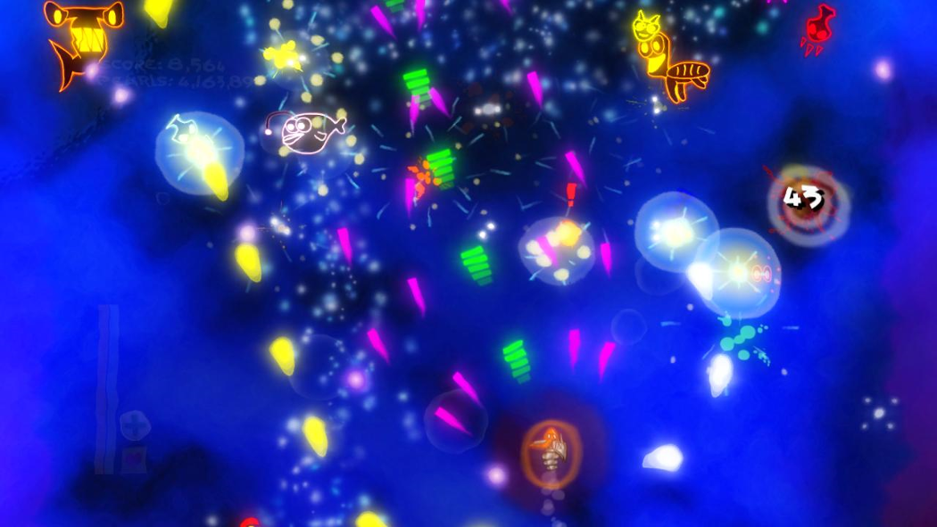
By combining these effects, simple images can be combined together into graphically impressive displays.

Slide 16
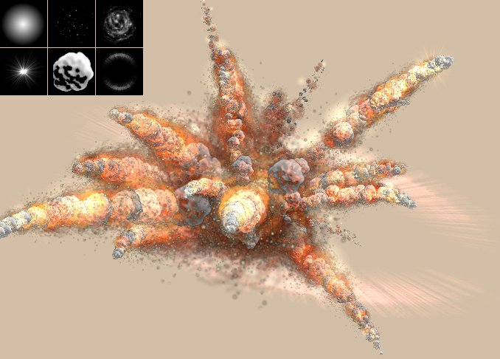
The explosion is made up from the combination of six simple images.
How would you combine the images to get a similar effect?
Start
10 mins
9 mins
8 mins
7 mins
6 mins
5 mins
4 mins
3 mins
2 mins
1 min
30 sec
Finished

Slide 17

Key takeaways:
Image rotation, scaling, fading and translation offer a very capable means of controlling how images are drawn.
Take the time to explore how you can best exploit these transforms within your own project.

